Slide 1
OOP and Elementary Data structures
Workshop 1

Slide 2
Recap
Variables
  Store data (int, float, str, bool, Nonetype)
Collections
  Collection of data (list, set, dict, tuples)
Conditional statements
  if, else, elif
Functions
  Group sections of code together
  def function_name():
Loops
  Used for repetitions (for, while)
Import statements
  Import code from external libraries or local files

Slide 3
Live code !
To recap, let's build a program that does the following:
  Takes an array of names as input
  Counts down from 10 to 0 waiting a second in between
  Randomly selects a name from the input array and displays it on the screen
  Must make use of the following:
    Functions
    Variables
    Collections
    Loops
    Import statements

Slide 4
Object Oriented Programming

Slide 5
What is it?
Object Oriented Programming (OOP) is a software design pattern that allows you to think about problems in terms of objects and their interactions.
Object oriented programming is a style of programming that groups related pieces of data together into objects. Furthermore, it allows objects to define their own methods.

Slide 6
Why?
It allows us to reason about real world objects using code.
It provides a clear modular structure for programs which reduces complexity and improves maintainability.

Slide 7
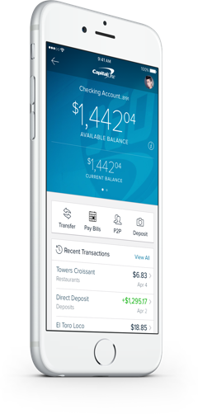
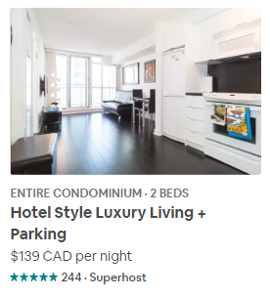

Usage
Object oriented programming is used everywhere. Some few examples:
Airbnb Flats
Facebook Posts
Bank accounts

Slide 8

Creating a cat object
Attributes
name
color
Methods
meow()
class Cat: def __init__(self, color, name): self.color = color self.name = name def meow(self): print("meowwww")

Slide 9
Bank account
Attributes
name
type
balance
Methods
deposit()
withdraw()
class BankAccount: def __init__(self, name, type, balance = 0): self.balance = balance self.type = type self.name = name def deposit(self, amount): self.balance += amount def withdraw(self, amount): if amount <= self.balance: self.balance -= amount else: print("Insufficient funds")
Bank accounts

Slide 10
Special methods
__init__: Constructor function, used when creating object
__repr__: String representation for developers
__str__: String representation for end users
__len__: Returns “length” of your object, called with len()
__add__: Describes how 2 objects should be added together
__eq__: Describes how 2 objects should be equivalent to each other
__lt__: Describes how one object can be less than another
…
Find more at https://dbader.org/blog/python-dunder-methods

Slide 11
Static methods, variables, and class methods
Shared among all instances
class Employee: ids = 0 # this is a static variable def __init__(self, name, salary): self.name = name self.salary = salary @classmethod def increment_ids(cls): cls.ids += 1 @staticmethod def increase_salary(employee): employee.salary += 400

Slide 12
Inheritance
EMPLOYEE
Attributes
name
Salary
Developer inherits name and salary from Employee
class Employee: def __init__(self, name, salary): self.name = name self.salary = salary class Developer(Employee): def __init__(self, name, salary, prog_language): super().__init__(name, salary) self.prog_language = prog_language def write_code(self): print("I'm writing some code...") class Manager(Employee): def __init__(self, name, salary, department): super().__init__(name, salary) self.department = department def file_report(self): print("I'm filing some reports")
Manager inherits name and salary from Employee
Developer
Attributes
prog_language
Methods
write_code()
Manager
Attributes
department
Methods
file_report()

Slide 13
Elementary Data Structures

Slide 14
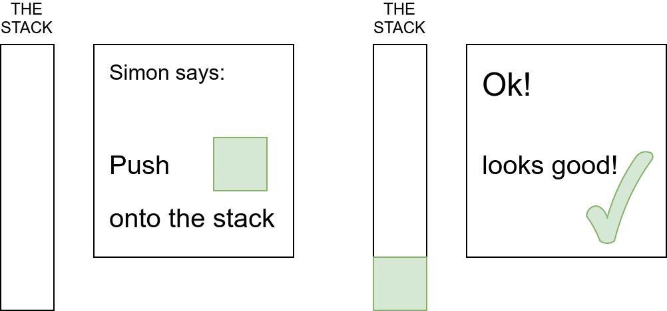
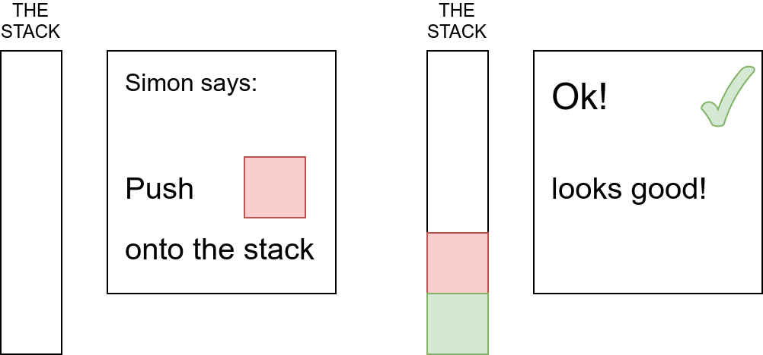
Stacks

Slide 15
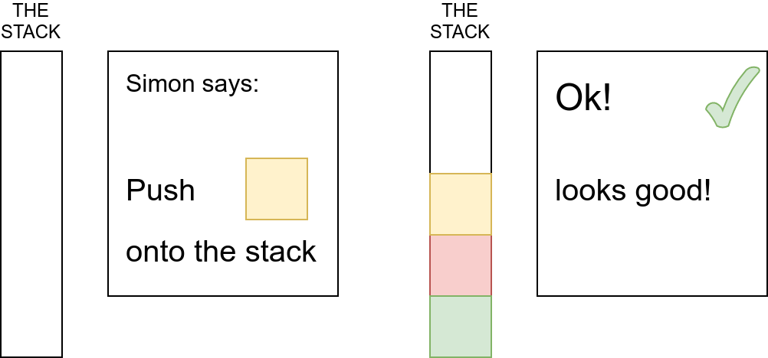
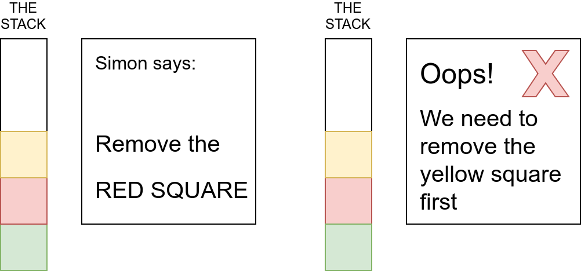
Stacks Continued

Slide 16
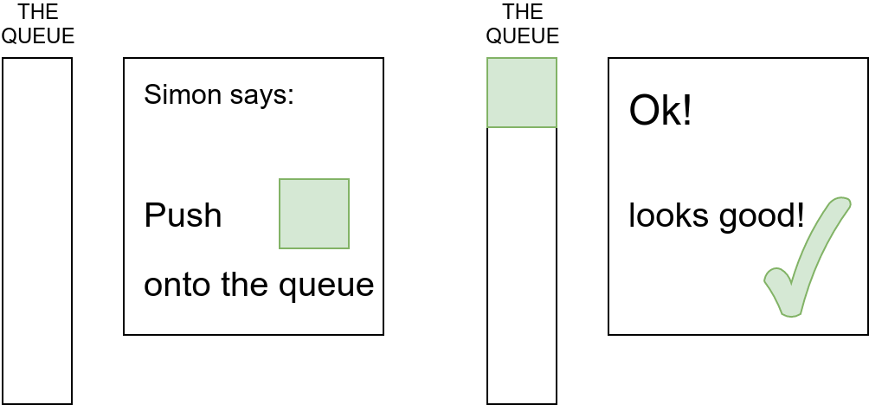
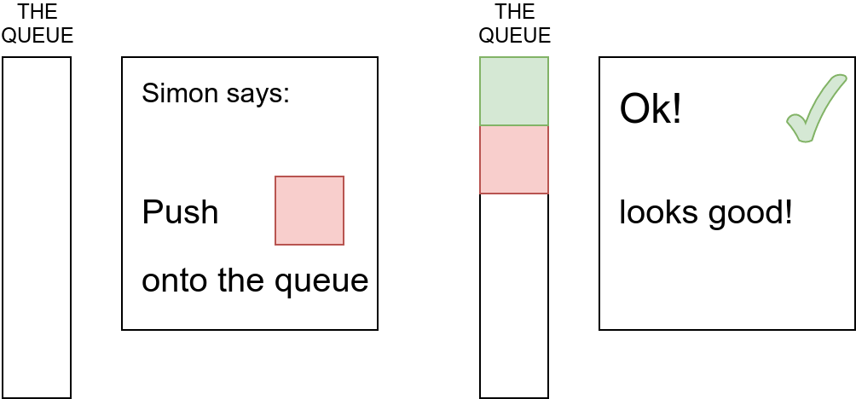
Queues

Slide 17
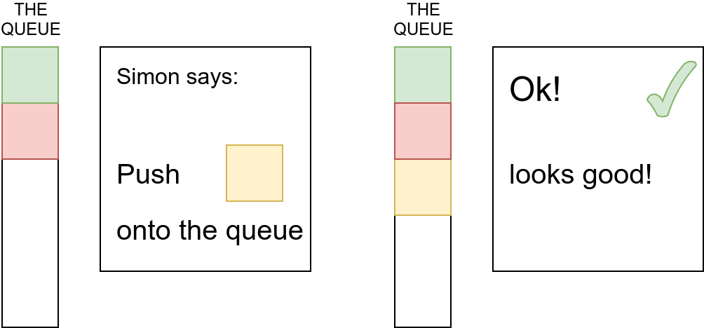
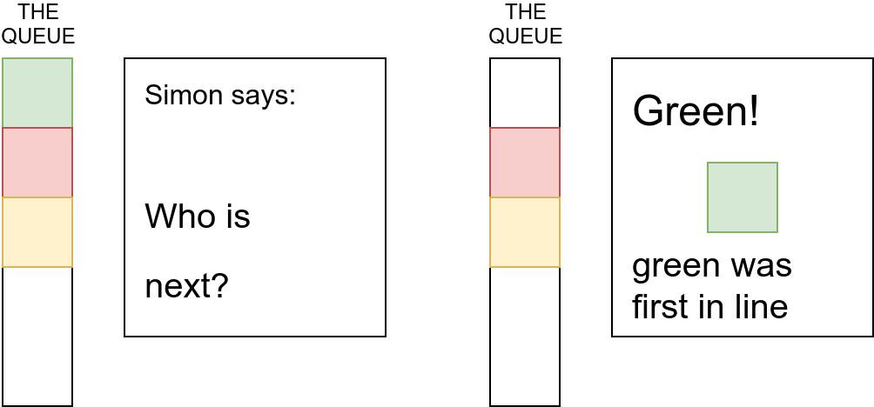
Queues Continued

Slide 18
Arrays
In a computer’s memory, it’s common to store data of the same type side-by-side.
0
1
2
3
4
5
6
7
Position
s
h
a
m
e
0
0
0
Value
What a shame!
Don’t worry - we’ll fix that!

Slide 19
Arrays continued...
To remove elements from an array, it is often necessary to shift everything else back into place.
For example, to remove “s” we simply move everything one cell back and then delete the last element
0
1
2
3
4
5
6
7
Position
0
1
2
3
4
5
6
7
Position
h
h
a
m
e
0
0
0
Value
h
a
a
m
e
0
0
0
Value
0
1
2
3
4
5
6
7
Position
0
1
2
3
4
5
6
7
Position
h
a
m
m
e
0
0
0
Value
h
a
m
e
0
0
0
0
Value

Slide 20
If we write a zero over the “e”, it says ham now.
Fixed it!
0
1
2
3
4
5
6
7
Position
h
a
m
0
0
0
0
0
Value

Slide 21
Arrays continued
When inserting an item into the middle of an array, it is always necessary to shift all of the items to make room!
This makes arrays inefficient for some uses.
Fortunately, there’s a solution!
0
1
2
3
4
0
1
2
3
4
0
1
2
3
4
0
1
2
3
4
A
B
D
E
A
B
D
D
E
A
B
D
E
A
B
C
D
E

Slide 22
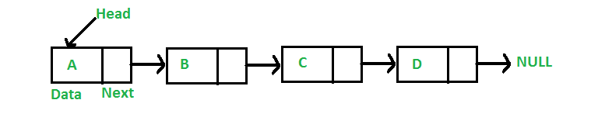
Linked Lists
“B” is located at
Position 3
0
1
2
3
4
5
6
7
8
9
10
11
Position
A
3
B
6
D
9
E
Value
This is called
a “node”
In a linked list, each location stores a value, and also the location of the next value.
3 is the position that comes after “A”

Slide 23
Linked Lists Continued
It’s okay to add C here;
no need to shift anything!
Let’s add “C” to the list!
S
0
1
2
3
4
5
6
7
8
9
10
11
12
13
14
A
3
B
6
D
9
E
C
0
1
2
3
4
5
6
7
8
9
10
11
12
13
14
“C” comes after “B”,
So update node B
A
3
B
12
D
9
E
C
0
1
2
3
4
5
6
7
8
9
10
11
12
13
14
“D” comes after “C”,
So update node C
A
3
B
6
D
9
E
C
6
Follow the pointers!
You should be able to read “A B C D E”

Slide 24
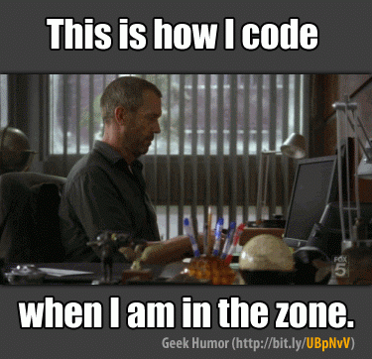
Exercises

